Slide 1
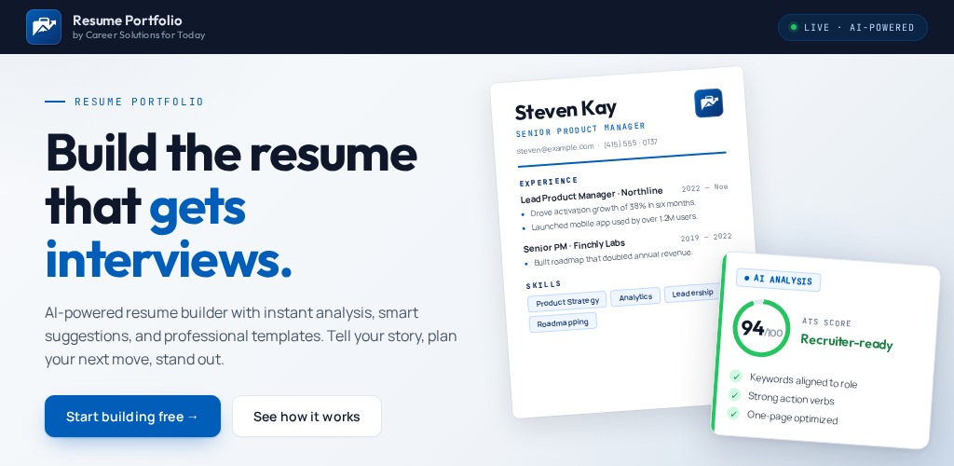

Slide 2

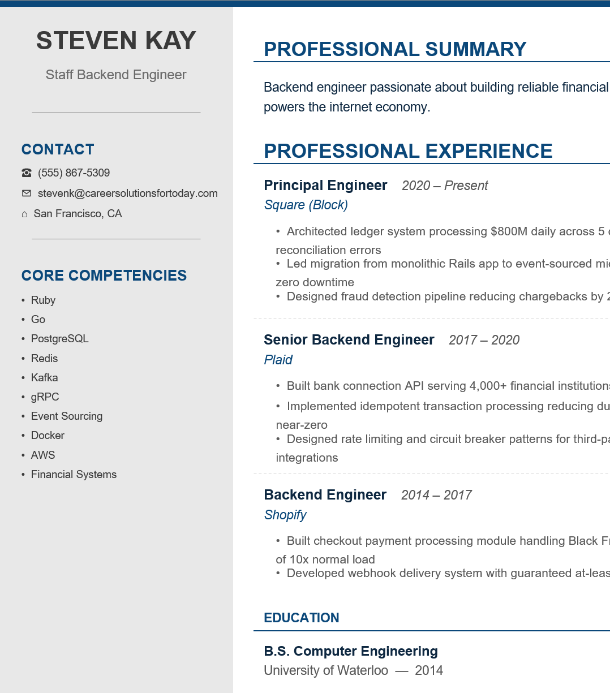
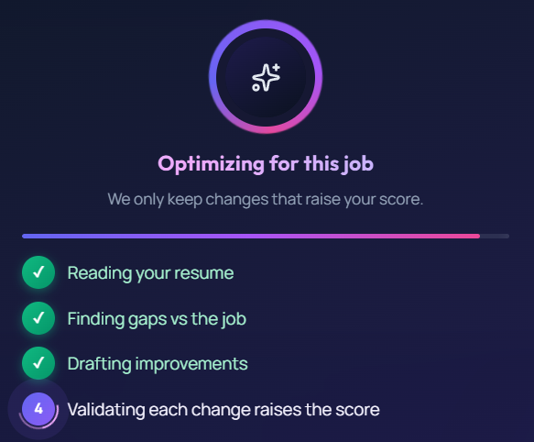
Resume Portfolio
Powered by Career Solutions for Today
Build the resume and plan that gets interviews.
AI-powered resume builder and storage with
Smart suggestions
ATS ready templates
Resume to job match scores
Shareable online links to highlight your skills

Slide 3


Slide 4
